Slide 1
EVALUATING COMPLIANCE AND INFRASTRUCTURE MODERNIZATION AT THE CITY OF LAWTON PUBLICLY OWNED TREATMENT WORKS (POTW): IMPLICATIONS FOR GENERATION FACILITY AND REGIONAL WATER MANAGEMENT
Danny Engle
M.S. Environmental Science – PSM
Committee: Michael Thayer, Bert Fisher, Kevin Blake, Damon Wright
December 11, 2025 | OSU–Tulsa

Slide 2
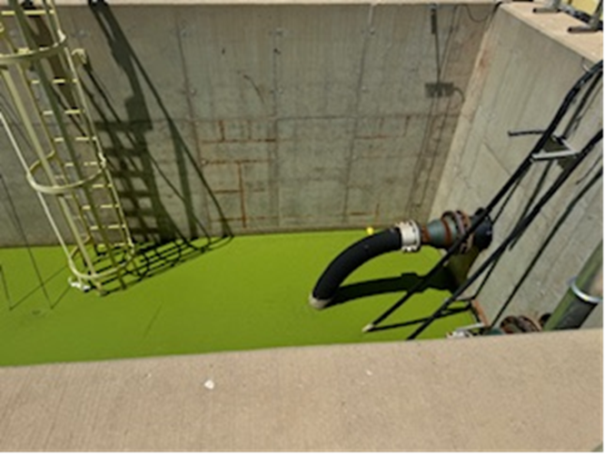
Project Context & Motivation
City of Lawton Wastewater Treatment Plant (WWTP) treats municipal wastewater and discharges effluent under an NPDES/OPDES permit.
PSO’s Comanche Generation Facility has relied on reclaimed effluent from the WWTP as its primary cooling water source for ~50 years.
Recent (NOVs, high ammonia, and a downstream fish kill raised concerns about WWTP performance and regulatory risk. Variable effluent quality creates operational, environmental, and compliance risks for both the WWTP and PSO.

Slide 3
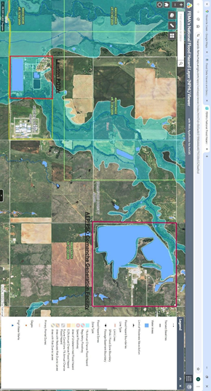
Problem Statement & Objectives
Lawton WWTP has a history of noncompliance with key permit limits (e.g., ammonia, TSS, CBOD, bacteria).
PSO depends on WWTP effluent quality to maintain its own NPDES compliance at the Comanche facility.
The WWTP is located in a mapped flood zone, increasing vulnerability of critical treatment infrastructure.
Objectives:
• Evaluate WWTP compliance and performance using NPDES monitoring data and enforcement records.
• Assess how variability in effluent quality affects PSO operations and regulatory exposure.
• Examine flood risk to the WWTP and implications for reliability.
• Recommend improvements in flood mitigation and intake monitoring.

Slide 4
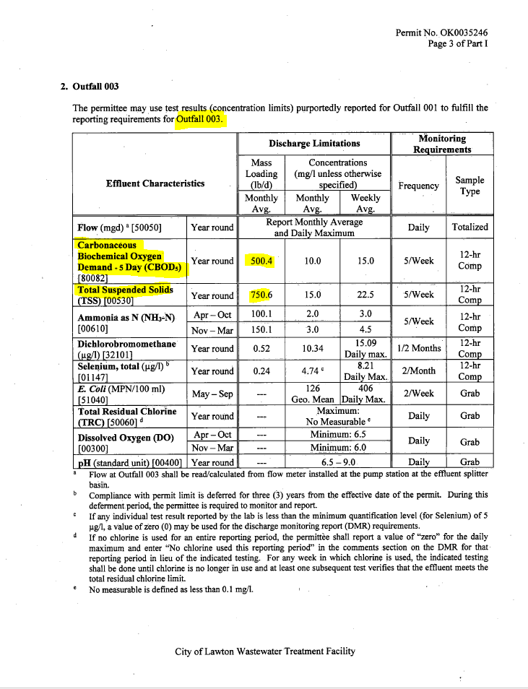
Regulatory Framework – Clean Water Act & NPDES
Clean Water Act (CWA) governs discharges of pollutants to waters of the United States.
National Pollutant Discharge Elimination System (NPDES/OPDES) permits set technology- and water-quality-based effluent limits.
Lawton WWTP: permit limits for ammonia, BOD/CBOD, TSS, bacteria, nutrients, metals, and operational parameters.
PSO Comanche: separate NPDES permit for discharge to Nine Mile Creek; compliance depends partly on WWTP influent quality.
Enforcement tools: routine monitoring and reporting, NOVs, consent orders, and potential penalties for repeat noncompliance.

Slide 5
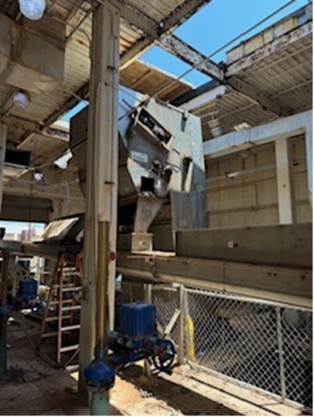
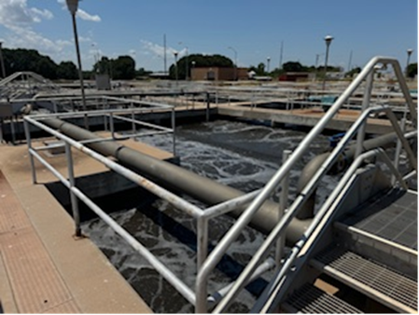
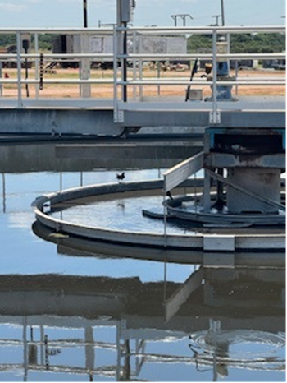
Lawton WWTP – Overview & Historical Challenges
Activated sludge facility with tertiary treatment and disinfection, serving the City of Lawton and industrial users.
Longstanding reputation for inconsistent effluent quality and repeated permit violations.
Recent issues reported by ODEQ and media:
• High ammonia levels in discharge.
• Downstream fish kill during upgrade activities.
• Ongoing construction and process changes to address performance problems.
Aging infrastructure and location within a mapped floodplain increase operational vulnerability.

Slide 6
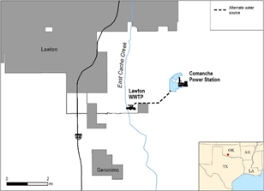
PSO Comanche Facility & Reclaimed Water Use
235 MW natural gas combined-cycle plant using a recirculating cooling pond.
Contract with City of Lawton (since 1970s) for up to 1.5–3.5 MGD of reclaimed wastewater.
Reclaimed effluent piped directly from WWTP to the cooling pond; PSO chlorinates and monitors pond water quality.
Advantages: reduces demand on scarce freshwater resources and enabled siting near Lawton and Fort Sill.
Risks: episodic spikes in pollutants from WWTP can propagate into PSO systems and affect Comanche’s NPDES compliance.

Slide 7
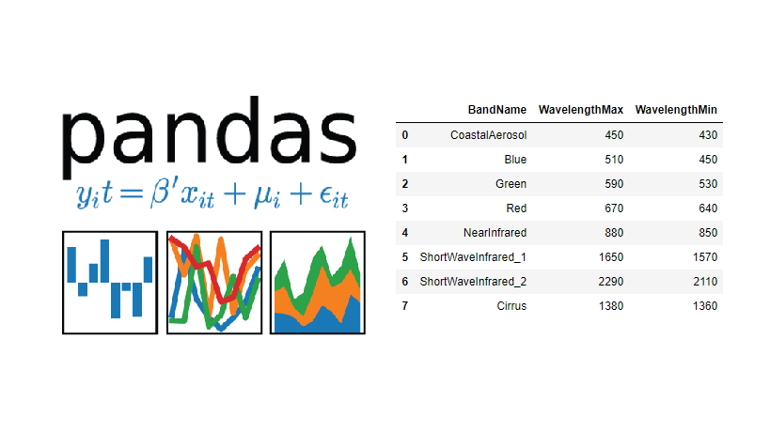
Methodology – Case Study & Data Sources
Qualitative case study design focused on the Lawton WWTP–PSO Comanche reclaimed water relationship.
Key data sources:
• EPA NPDES monitoring dataset for Lawton WWTP (Outfall 003).
• ODEQ Notices of Violation and public reports.
• Water supply contract and 2021 addendum between City of Lawton and PSO.
• News reports on ammonia violations, fish kill, and plant upgrade progress.
• Site visit and professional mentorship input (Dr. Tim Lohner, PSO Environmental Permitting).
EPA dataset analyzed using Python/pandas; details and scripts documented in Appendix A and GitHub repository.

Slide 8
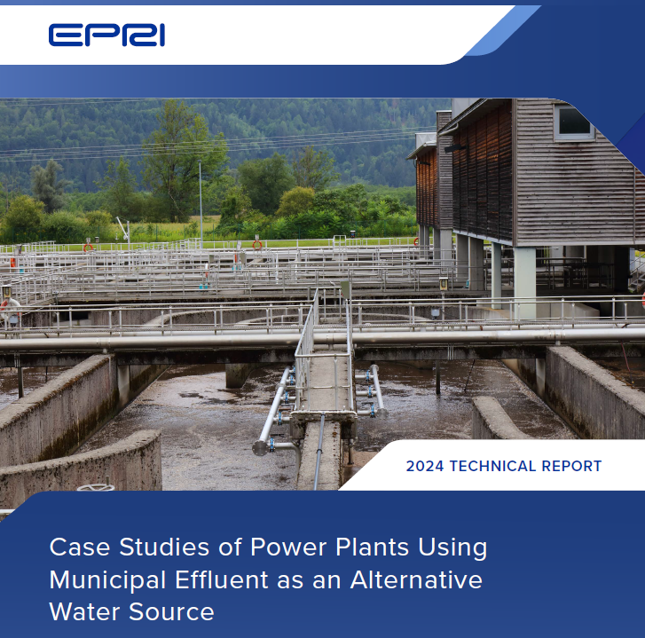
Key Findings – NPDES Performance & Pollutants
EPA monitoring data (2007–2024) show episodic exceedances of several pollutants at Outfall 003.
Parameters of greatest concern for PSO and aquatic life:
• Ammonia nitrogen (NH₃-N): repeated exceedances and focus of recent NOVs.
• CBOD/BOD and TSS: indicate incomplete treatment or process upsets.
• Fecal coliform/E. coli: reflect disinfection performance.
Source attribution:
• Sewage-related parameters (NH₃-N, CBOD, TSS, bacteria) clearly originate at the WWTP, not PSO operations.
• Thermal and some corrosion-related parameters are primarily linked to PSO systems.

Slide 9
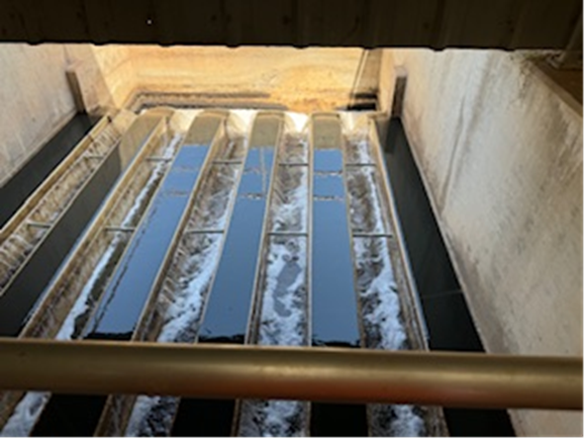
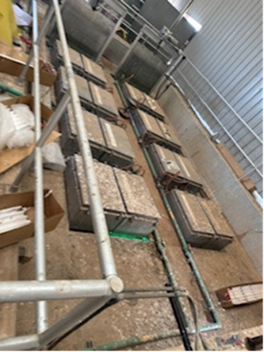
Key Findings – Flood Risk & Infrastructure
WWTP is located within a mapped flood zone near 34.52803, -98.36742.
Flooding could:
• Disrupt aeration, secondary clarification, and disinfection processes.
• Cause uncontrolled bypasses or overflows of partially treated wastewater.
• Damage electrical systems, pumps, and chemical storage.
Ongoing multi-phase upgrade project includes some relocation and elevation of critical assets, but residual risk remains.
Flood resilience is integral to maintaining long-term CWA compliance and reliable reclaimed water supply to PSO.

Slide 10
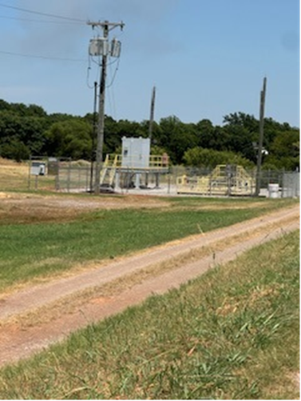
Impact Analysis – PSO & Lawton Community
For PSO:
• Variable WWTP effluent quality increases treatment and monitoring burden at Comanche.
• Noncompliant influent can translate into NPDES risk for PSO, even when sources are upstream.
• Cooling pond ecology (e.g., algae, eutrophication) is sensitive to nutrient and solids loading from WWTP.
For Lawton community:
• Environmental impacts include fish kills and degraded downstream water quality.
• Public confidence in local infrastructure and environmental stewardship is affected by repeated violations.
• Significant capital investment (~$85–370 million) reflects the economic stakes of modernizing the WWTP.

Slide 11
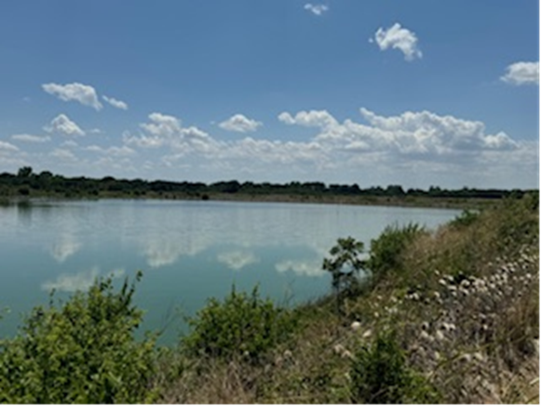
Recommendations – Flood Mitigation at WWTP
Short- to medium-term actions:
• Elevate or protect critical electrical and control systems above base flood elevation.
• Install or enhance berms, floodwalls, and site drainage to reduce inundation risk.
• Implement structural floodproofing (e.g., sealed doors, backflow prevention).
Long-term strategy:
• Continue relocating the most vulnerable process units and controls out of the floodplain as part of major upgrades.
• Integrate flood risk explicitly into WWTP master planning and capital budgeting.

Slide 12
Recommendations – PSO Intake Monitoring & Collaboration
Install continuous monitoring at the PSO intake point for key parameters (e.g., NH₃-N, TSS, temperature, pH).
Set internal trigger thresholds to allow operational adjustments when WWTP effluent quality degrades.
Share monitoring data with the City of Lawton to:
• Improve situational awareness during upsets or storm events.
• Support joint troubleshooting and process optimization.
Use long-term data trends to refine contracts, contingency planning, and infrastructure investments for both parties.

Slide 13
Conclusions & Lessons Learned
Lawton WWTP’s historical noncompliance and flood exposure create shared risk for both the City and PSO Comanche.
NPDES monitoring data confirm episodic exceedances of ammonia, CBOD, TSS, and bacteria at Outfall 003.
Sewage-related pollutants observed at PSO are reasonably attributable to WWTP performance, not generation operations.
Planned WWTP upgrades and targeted flood mitigation can substantially improve reliability and compliance.
Independent intake monitoring at PSO, combined with stronger data sharing, can reduce regulatory and operational risk.
The case illustrates the importance of resilient infrastructure and municipal–industrial collaboration in reclaimed water use.

Slide 14
Questions & Discussion
Thank you for your time and consideration.
Questions from the committee and audience?

